Slide 1
Experience Design
Week 4 – User Study (continued)

Slide 2
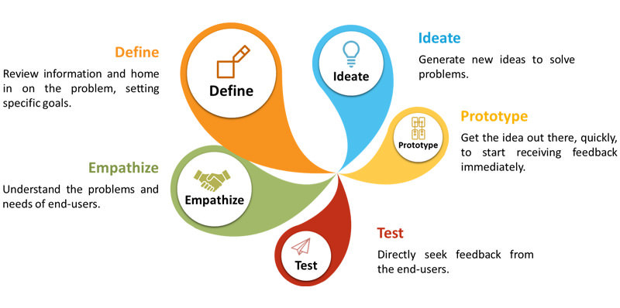
UX cycle
Weeks 7 & 8
Weeks 3, 4 & 5
Week 13
Notes:
Note: update!

Slide 3
User study agenda
Week 3
Why study (the user)?
User selection
User study techniques
Survey
Interview
Observation
Data analysis
Personas, user requirements capture
Week 4
Week 5
Notes:
Note: update schedule…

Slide 4
Topics in this presentation
Interview
Observation
Resources
Week 4 – practical

Slide 5
USER STUDY TECHNIQUES…

Slide 6
Common user study techniques
Survey
Interview
Observation
Notes:
Note: update tick marks based on schedule

Slide 7
Interview
Popular method of user study
Normally 2-3 interviewers interview a user at a time
What are the typical topics covered?
Background
Use of technology
Use of the product
Main objectives and motivations
Troubles using the product

Slide 8
How to conduct an interview…
Prepare questions
Schedule interview
Conduct interview
Broad questions first, then product-specific questions.
Invite participant(s)
Write down exactly what the user says, or record the interview
Observe body language of user
Notes:
Body language -> additional inputs

Slide 9
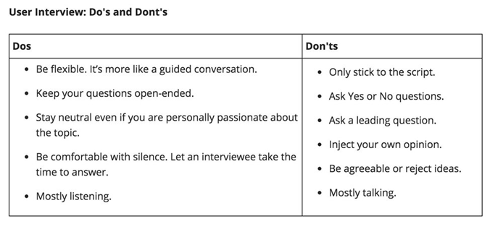
Interview…
Notes:
What questions will you ask as an interview for the travel application?

Slide 10

Video time
Watch this video to know some tips and tricks for conducting an interview.
https://www.youtube.com/watch?v=8tiuWYs5Z-A

Slide 11
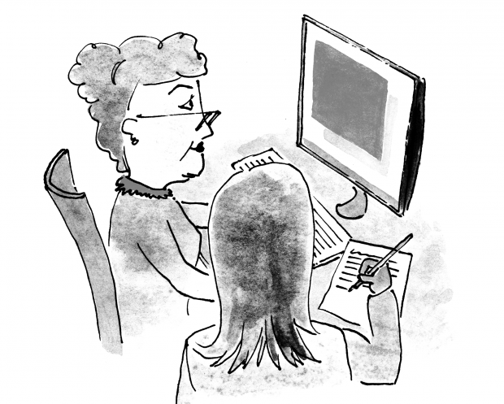
Observation
Accompany the user and observe how the user uses the product within the natural environment.
Observing users interacting with a product can be a great way to understand the usability of a product and the overall user experience.
What people say they do is not always what they actually do…
Notes:
Observation is also called shadowing.
Watching and listening to people, usually in public places, and trying to form some ideas about their behaviour, knowledge, and beliefs.
Beware of the Hawthorne effect: the act of observation of someone doing something can change their approach to carrying out the task.
Do not interfere or ask questions during the process

Slide 12
How to carry out an observation…
Set expectations
Schedule observation
Conduct session
Decide what you expect to learn from this observation.
Recruit participants.
Sit, watch and record (notes, video) what you see and hear (user journey).
Observe body language of user.
Notes:
Conduct session: Write down and/or record interesting events that happen as user operates in the environment.
Many normal surveys include some observations. There’s usually no need to ask "Which gender are you?" Instead, the interviewer notes whether the respondent is a man or woman. That’s observation.
Create a “user journey”: capture important steps in an observation sheet.
For observation to be successful, you must often go beyond observation, and ask people "Why do you do that?" You are not observing purely for the sake of observing, but to find out why people act as they do.

Slide 13
Group discussion
Discuss in groups the advantages and disadvantages of the three methods of user study you have learned about.
Survey
Interview
Observation
When would you use which method?
Which is your preferred method and why?
Present all your results.

Slide 14
Survey – advantages and disadvantages
Advantages
low cost
quick
can be done online with many participants; researcher need not be present
results are statistically significant
Disadvantages
inflexible design
possibly inappropriate questions
“neutral/no opinion’” answers

Slide 15
Interview – advantages and disadvantages
Advantages
can get detailed and accurate information
capture verbal and non-verbal cues
user is more focussed
Disadvantages
huge cost – recruiting interviewers
manual data entry

Slide 16
Observation – advantages and disadvantages
Advantages
easy to conduct
gives in-depth understanding
could reveal usability issues.
Disadvantages
could be time-consuming; 30 minutes to several weeks
manual data entry
depends a lot on the observer -> too subjective

Slide 17
RESOURCES

Slide 18
Online resources
In addition to resources mentioned last week:
http://designingwithpeople.rca.ac.uk/methods/interview
https://medium.springboard.com/the-art-of-the-user-interview-cf40d1ca62e8
https://www.interaction-design.org/literature/article/shadowing-in-user-research-do-you-see-what-they-see

Slide 19
RECAP

Slide 20
Topics discussed
More user study techniques
Interview
Observation
Comparison of the 3 techniques

Slide 21
Before the upcoming practical lesson…
Watch these videos.
How NOT to conduct an interview (bad example)
https://www.youtube.com/watch?v=U4UKwd0KExc
How to conduct an interview (good example)
https://www.youtube.com/watch?v=eNMTJTnrTQQ
Notes:
Video 1 ( bad example): Around 10 mistakes: Too many distracting hand motions, doesnt keep eye contact, asked closed ended questions (yes/no), asked leading questions (did you like the training?), gave leading answers (keeping voice softer, etc), spoke too quickly, insulted the interviewee (you're contradicting yourself! you're changing your mind!)
Interviewer seemed bored by the presence of the participants and was too preoccupied with her cell phone, she interrupted the response of the participant and she over talked the person she was interviewing and lastly, she asked a lot of short answer questions.
Video 2 (good example): Interviewer shows good quality of attention and listening, uses open questions and shows she values the answers, is aware respondent might be sensitive about admitting her needs, and guides her gently into offering realistic suggestions.

Slide 22
WEEK 4 – PRACTICAL

Slide 23
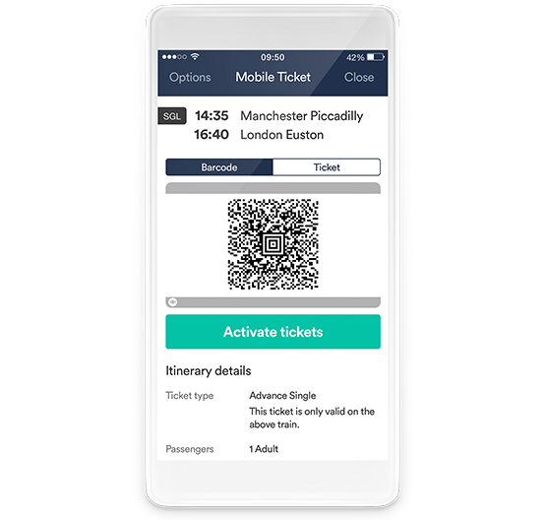
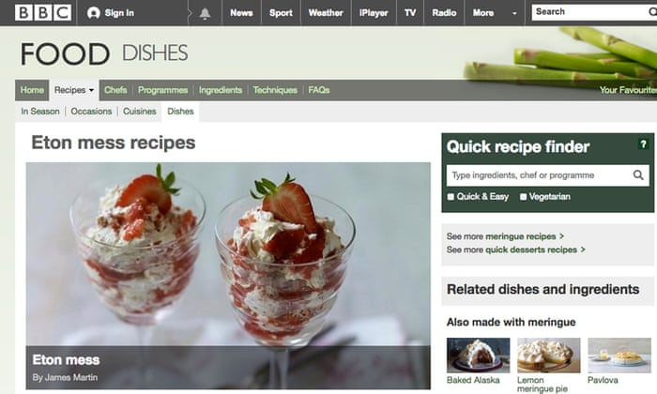

Task – interview
Divide yourselves into groups of 3 (one user and two interviewers) and conduct an interview as part of UX research, for any one of
Recipes website
Train travel app
Game
Notes:
Note: same groups as for survey

Slide 24
Task – interview…
Switch roles after some time (so that each student can act as interviewer at least once).
Time: 40 minutes
What were your findings? Talk about them to the class!
Did you encounter any difficulty as an interviewer?
Did the interview proceed as you expected?
Did your user portray any non-verbal cue? Were you able to capture it?
Did you get a good idea of your user’s needs and problems?

Slide 25
Next lesson…
Data analysis
Personas, user requirements capture
Introduction to user study assignment for weeks 3-5

Slide 26
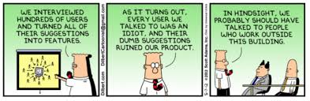
Questions?

Slide 27
Feedback
Lesson
Interesting?
Informative?
Difficult?

